Slide 1
Caribou Public Safety Building Options
Options for Public Safety Building
Option A – Combined Fire & Police Departments at Birdseye
Option B – Police Department at Birdseye
Option C – New Police Department & Renovated Fire Department on High Street
Option D – Combined Fire & Police Departments on High Street
Option E – Police Department on Sweden Street

Slide 2
Caribou Public Safety Building Options
Total Project Budget Includes:
Construction Cost
Permitting
Testing, Survey and Similar
Architectural and Engineering Fees
Systems – IT, AV, Security and Similar
Furniture, Fixtures and Equipment

Slide 3
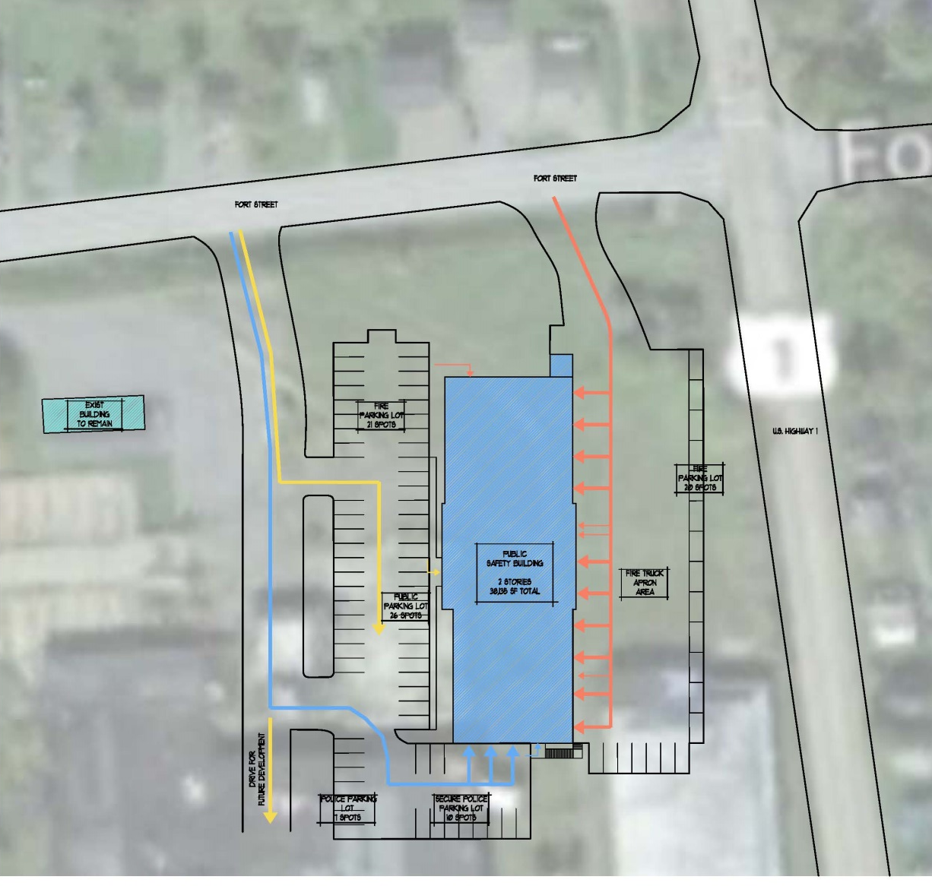
Caribou Public Safety Building Options
Option A – Site Plan
Site Plan

Slide 4
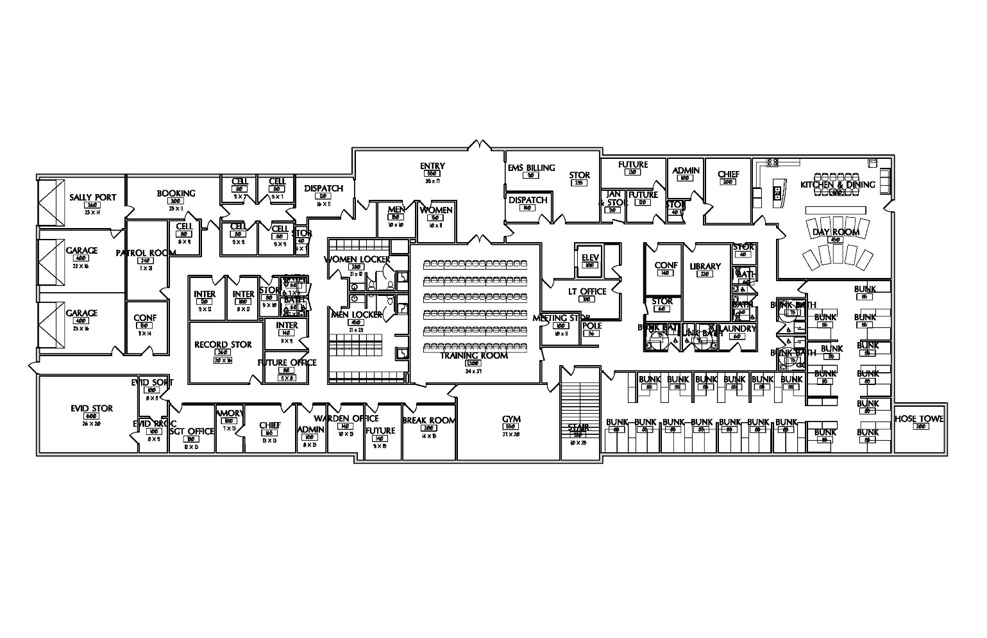
Caribou Public Safety Building Options
Option A – First Floor

Slide 5
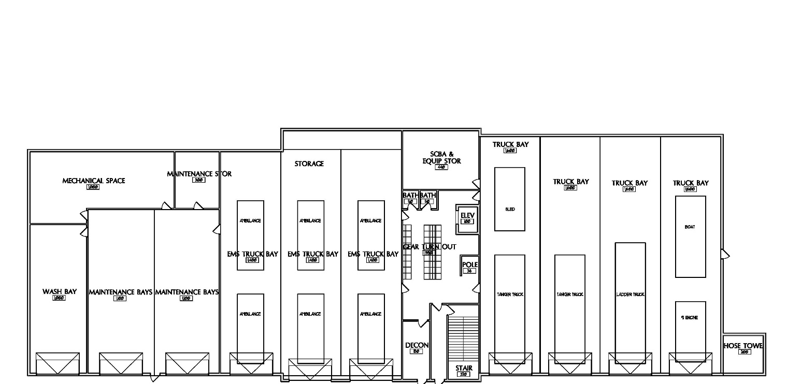
Caribou Public Safety Building Options
Option A – Lower Level

Slide 6
Caribou Public Safety Building Options
Option A – Cost Estimate

Slide 7
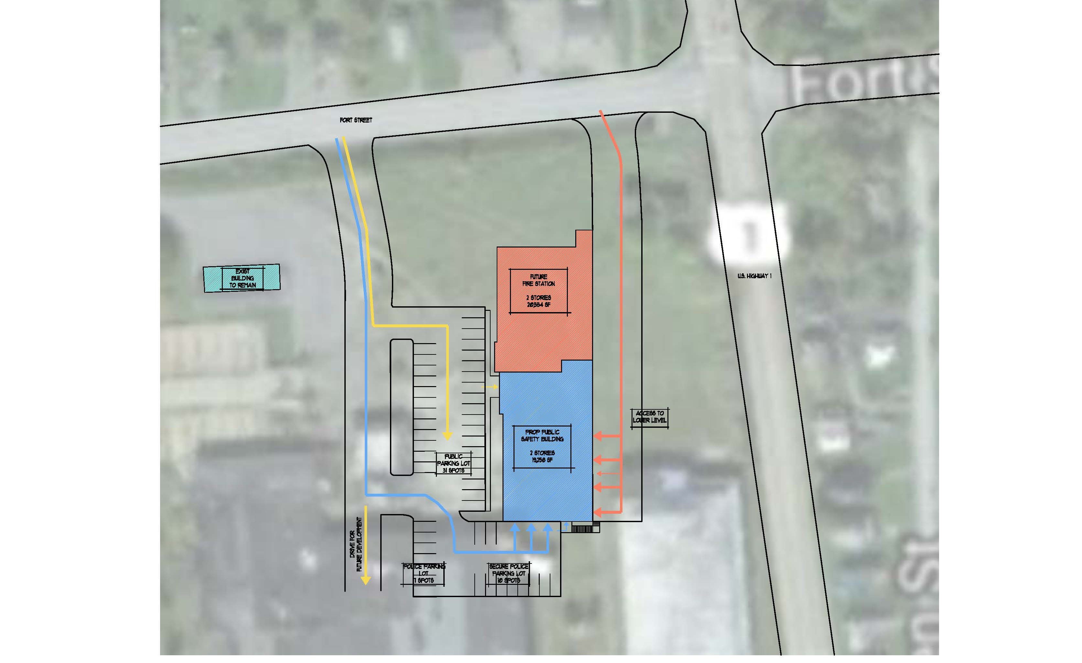
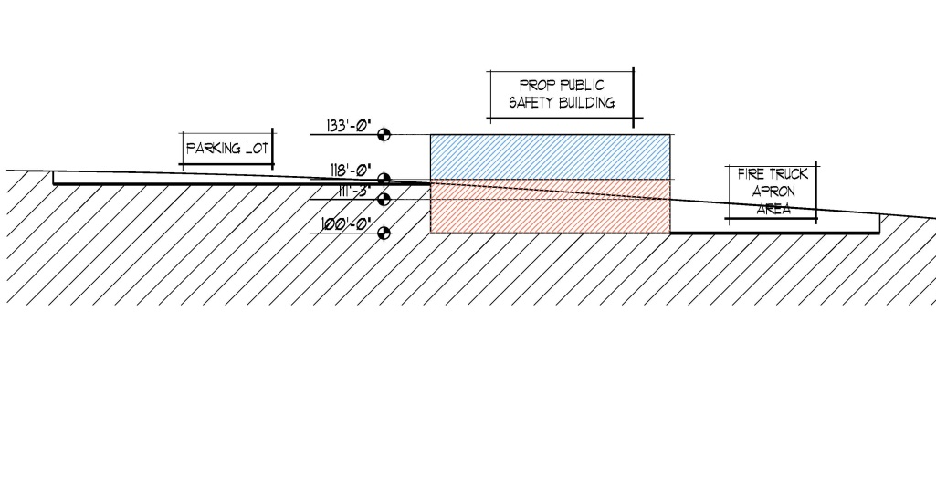
Caribou Public Safety Building Options
Option B – Site Plan

Slide 8
Caribou Public Safety Building Options
Option B – First Floor & Lower Level

Slide 9
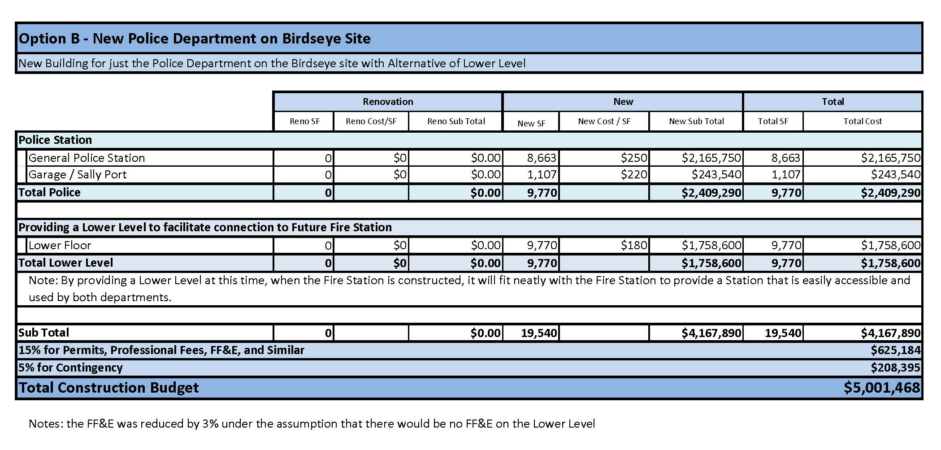
Caribou Public Safety Building Options
Option B – Cost Estimate

Slide 10
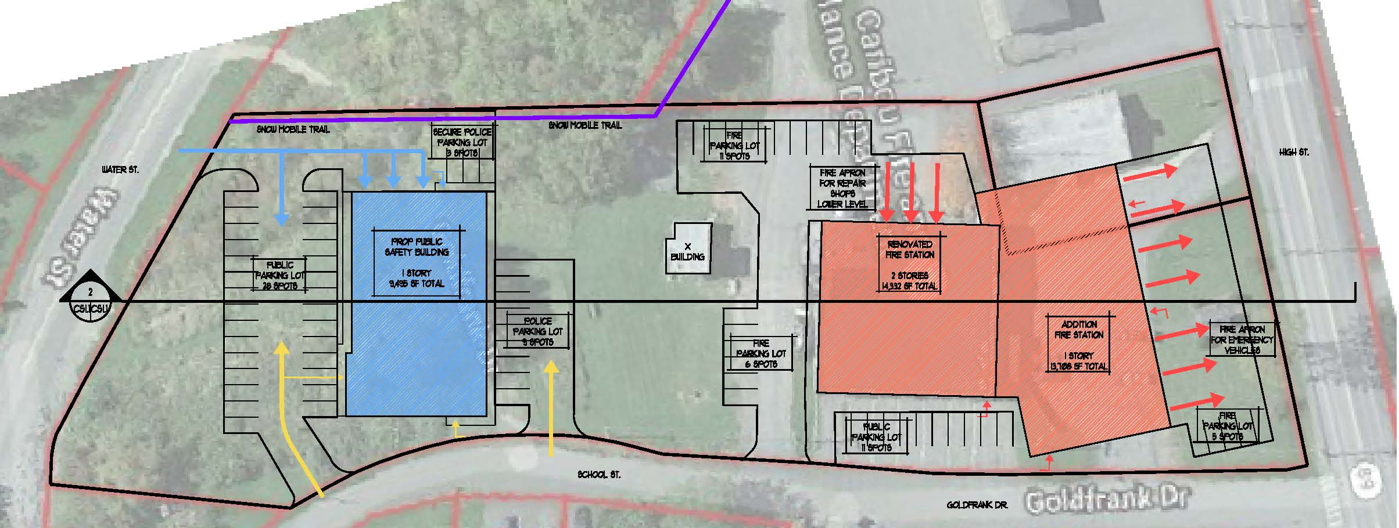
Caribou Public Safety Building Options
Option C – Site Plan

Slide 11
Caribou Public Safety Building Options
Option C – Police Floor Plan

Slide 12
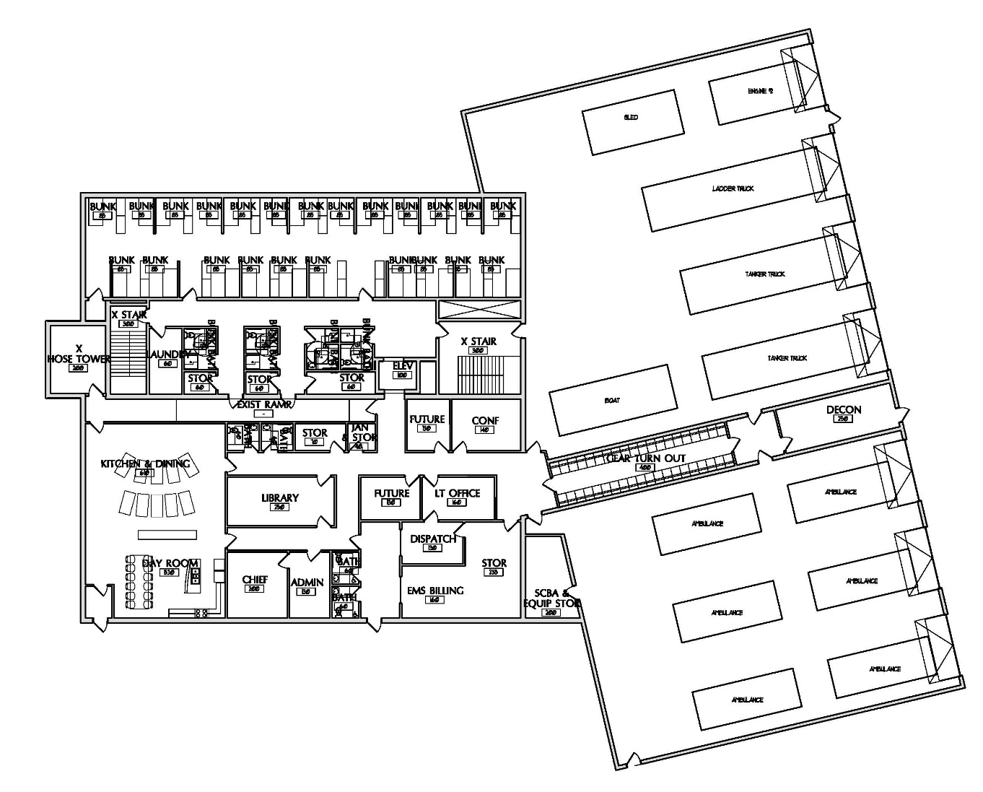
Caribou Public Safety Building Options
Option C – Fire Station First Floor

Slide 13
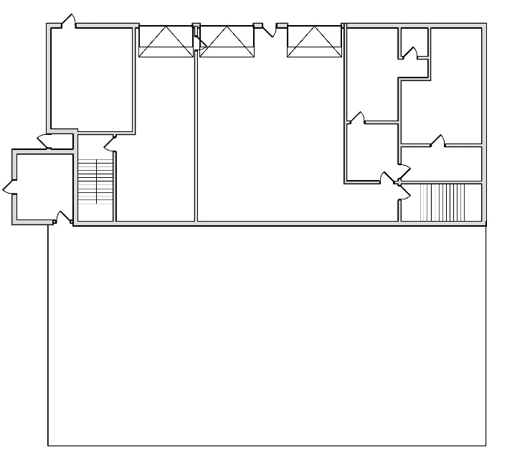
Caribou Public Safety Building Options
Option C – Fire Station Lower Level

Slide 14
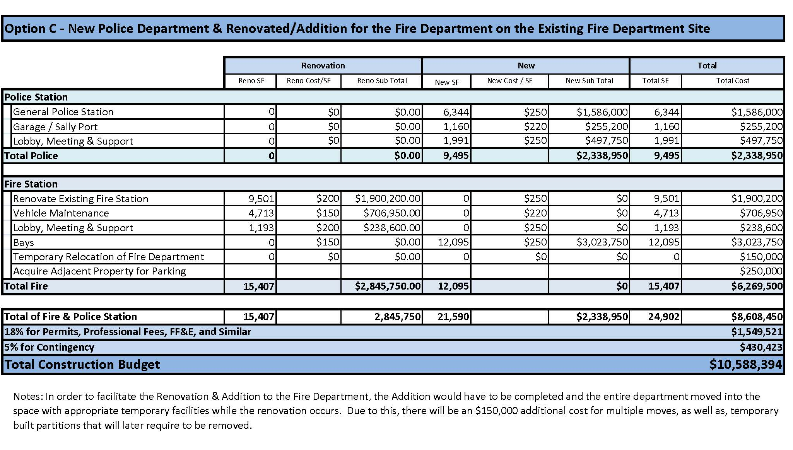
Caribou Public Safety Building Options
Option C – Cost Estimate

Slide 15
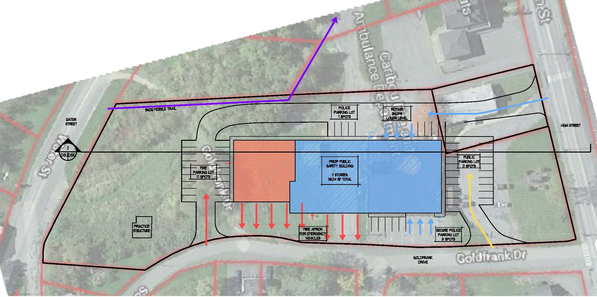
Caribou Public Safety Building Options
Option D – Site Plan

Slide 16
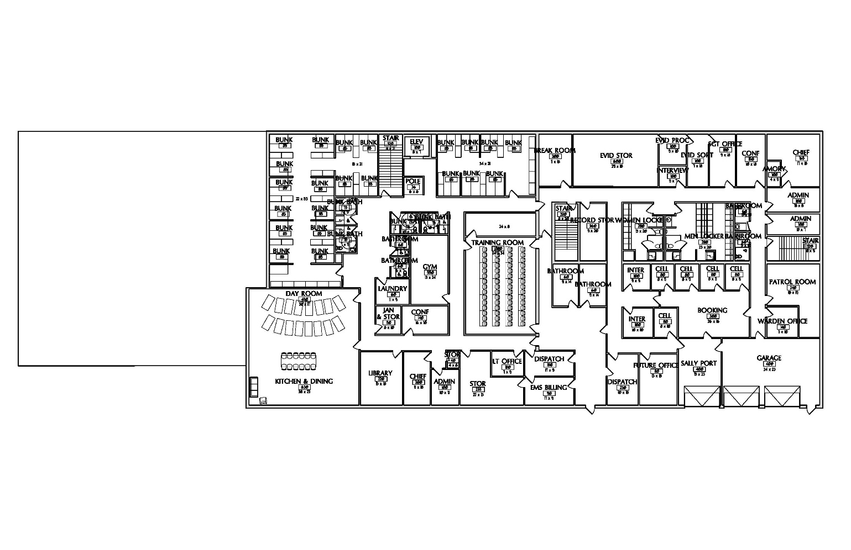
Caribou Public Safety Building Options
Option D – First Floor

Slide 17
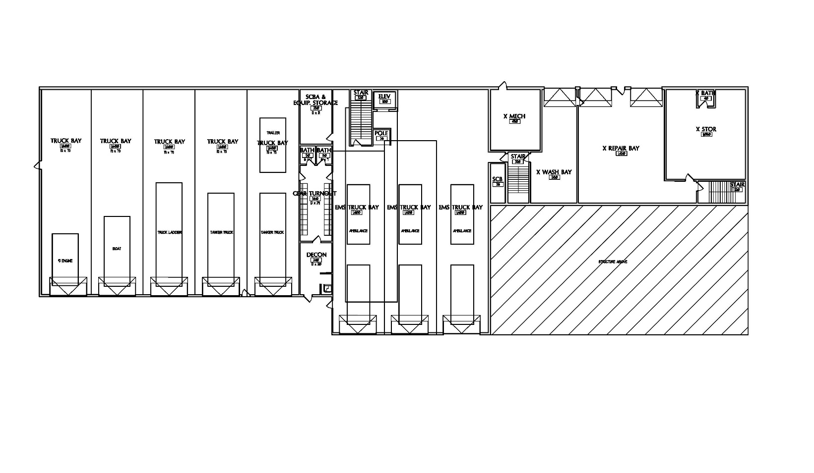
Caribou Public Safety Building Options
Option D – Lower Level

Slide 18
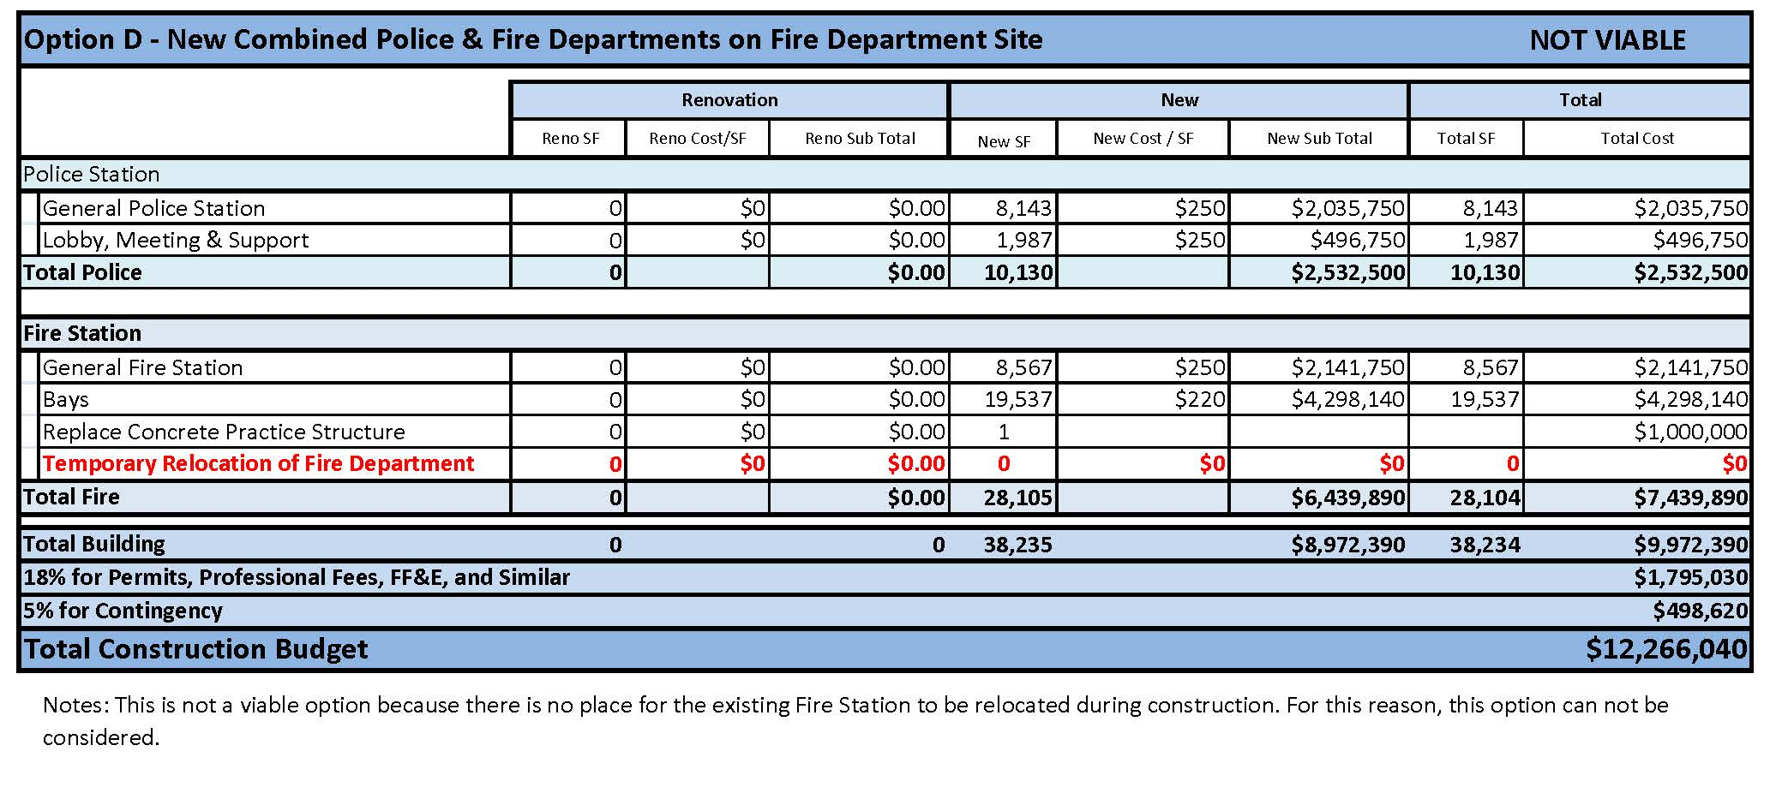
Caribou Public Safety Building Options
Option D – Cost Estimate
Not Viable

Slide 19
Caribou Public Safety Building Options
Option E – Site Plan

Slide 20
Caribou Public Safety Building Options
Option E – Police Floor Plan

Slide 21
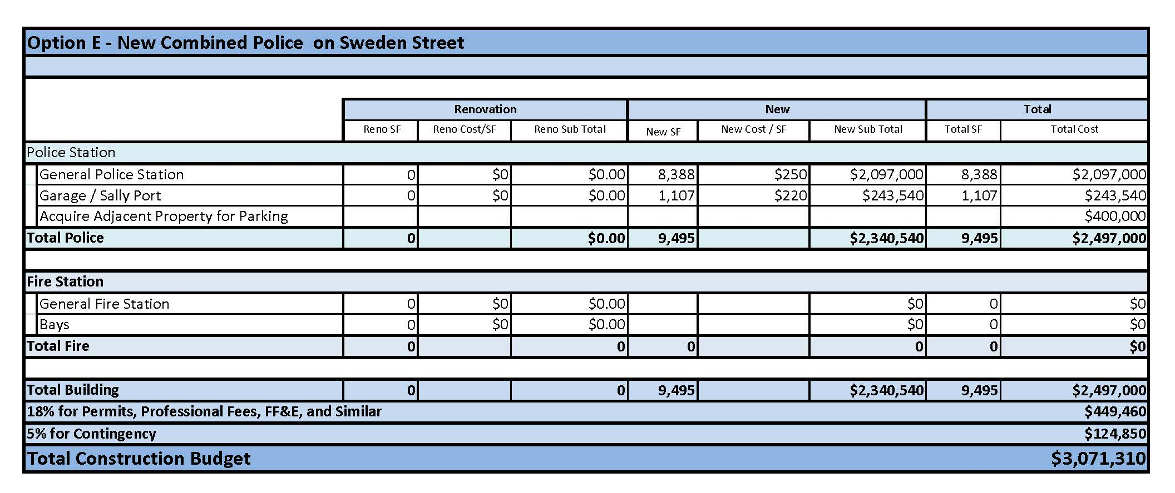
Caribou Public Safety Building Options
Option E – Cost Estimate

Slide 22
Caribou Public Safety Building Options
Comparison

